Slide 1
School Safety Review
Albemarle County Public Schools

Slide 2
School Safety Review
The purpose of the School Safety Review is to make school safety planning more public and collaborative.

Slide 3
School Safety Review Three Year Rotation
Year One (2018-2019) | Year Two (2019-2020) | Year Three (2020-2021)
Albemarle | Broadus Wood | CATEC
Agnor-Hurt | Brownsville | Greer
Baker-Butler | Burley | Hollymead
Henley | Cale | Murray HS
Jouett | Crozet | Red Hill
Meriwether Lewis | Murray/Charter | Stony Point
Monticello | Stone-Robinson | Sutherland
Western Albemarle | Scottsville | Woodbrook
Walton

Slide 4
School Safety Review Components
School Safety and Climate Data Review (20 minutes)
School Safety Walk (20 minutes)
Review of Standard Crisis Management Practices (15 minutes)
Table Top Exercise (45 minutes)

Slide 5
School Safety and Climate Data Review
Data Sources for this component include the following:
ACPS Climate Survey Data (Elementary and Secondary)
Virginia School Climate Data (Secondary)
School Safety Audit Recommendations
School Safety Inspection Checklist
Annual School Safety Survey
School Based Climate Data
Peer Nomination Data

Slide 6
School Safety and Climate Data Review
Administrators should be prepared to discuss the following:
What school climate data points are encouraging or concerning for your school?
What strategies has your school employed to address any negative school climate trends that have emerged for your school?
What school climate related school improvement goals has your school focused on in recent years? What were the results?
Are there particular data points that will inform school improvement goals in the future?
Did your school safety checklist review produce any areas of specific concern for student safety?

Slide 7
School Safety Walk
Data Sources for this component include the following:
School Safety Inspection Checklist (Elementary and Secondary)
Virginia School Climate Data (Secondary)
School Safety Audit Assessment
Annual School Safety Survey

Slide 8
School Safety Walk
Administrators should be prepared to discuss the following:
What specific physical safety concerns have you identified in your review of school data including the School Safety Inspection Checklist.
Be prepared to escort the group of observers to the area of concern or provide photographs, explain the concern and your proposed solution for the concern.

Slide 9
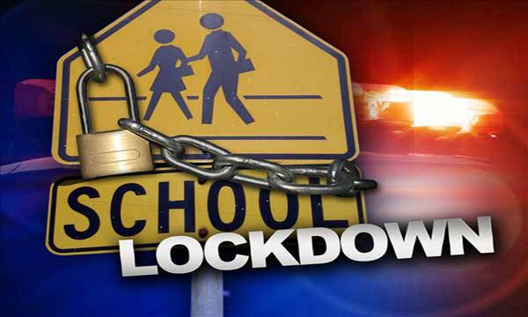
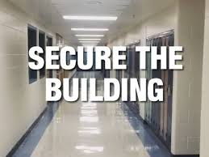


Standard Crisis Management Practices
Lockdown
Secure the Building
Shelter in Place
Evacuate the Building

Slide 10
Table Top Exercise - 45 minutes
The purpose of a tabletop exercise is to examine current policies, procedures, resources and actions in the context of a response to an emergency in the school setting.
During the tabletop exercise, an emergency situation in the school or impacting the school will be proposed for consideration.
During the session, the school crisis team will work together to consider the situation and discuss how the school would respond to the emergency situation in real time.
This process is intended to be collaborative and iterative.

Slide 11
Student Anonymous Reporting System Progress
A team of ACPS staff members invited a number of companies that provide this type of service to present their products for consideration in October.
A team of ACPS staff members recently visited a local school division that is currently using one of these products to review their use, learn about their implementation process and get their feedback about the effectiveness of these products.
An RFP has been developed and forwarded through the appropriate channels, placing us in line to make a final decision and a purchase.

